Slide 1
Final report
Team 1
Group 6

Slide 2

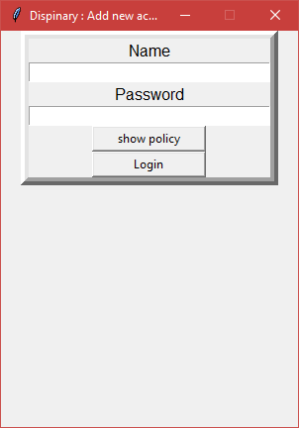
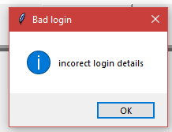
Program progress
Login screen
Will require a user’s first name and password
Will open the main disciplinary action screen if successfully logged in
Shows error message if incorrect name or password enter
Has a policy button to show the company’s policy

Slide 3
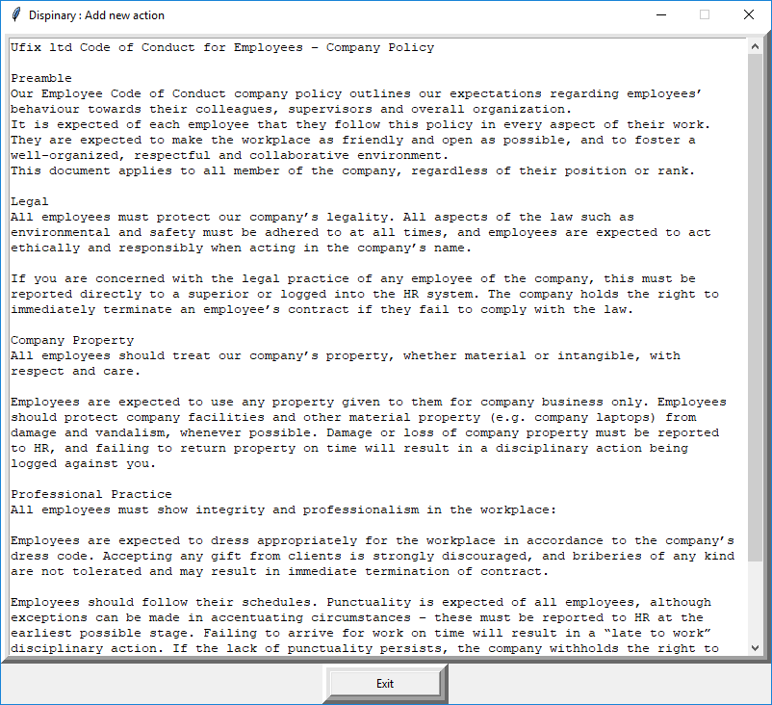
Program progress
Policy screen
Shows company Policy

Slide 4
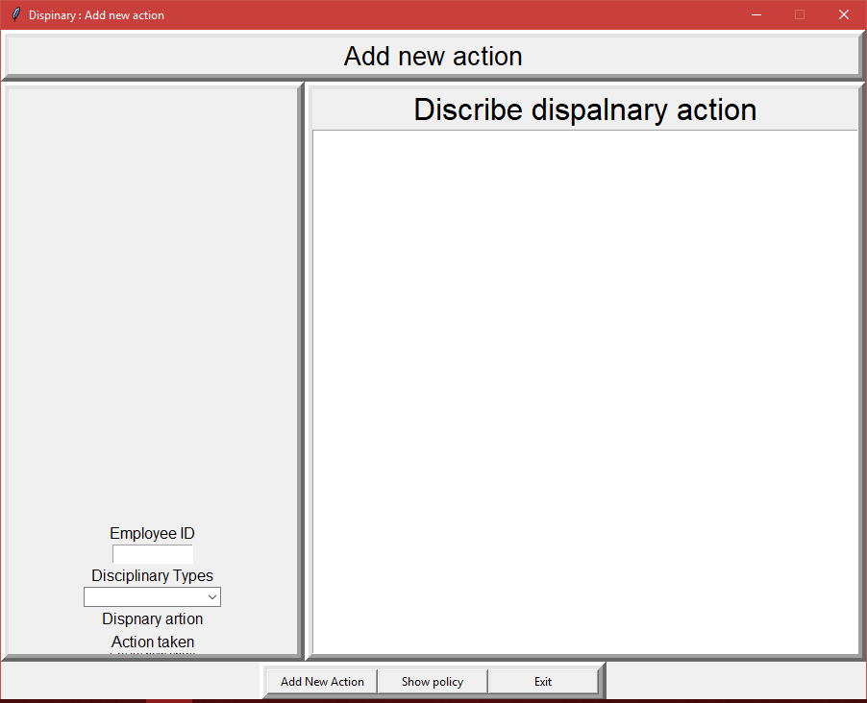
Program progress
Disciplinary action

Slide 5
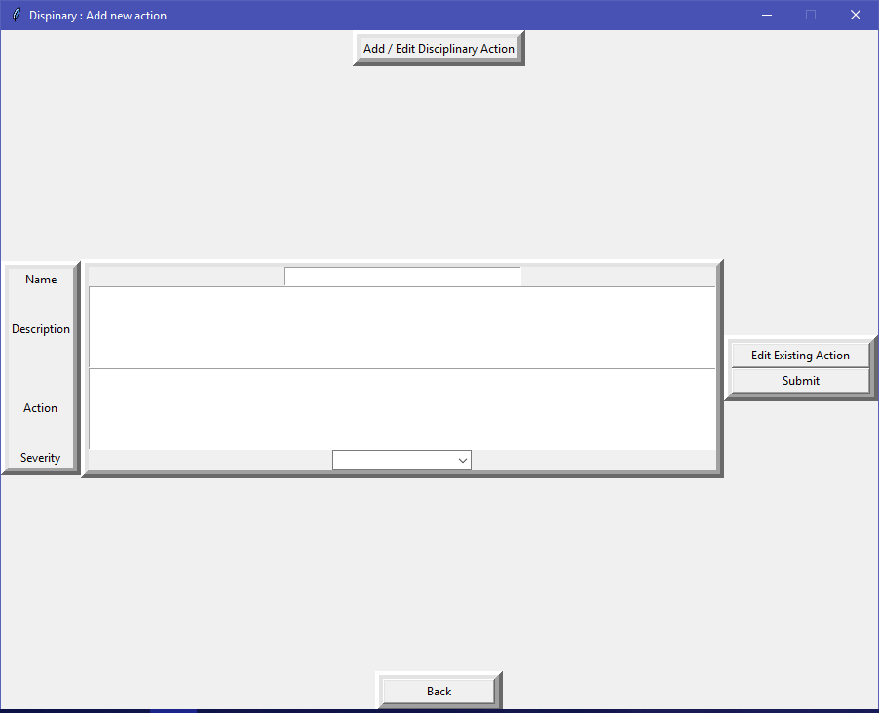
Program progress
Disciplinary action

Slide 6
Testing
Some test cases have been created
Some tests have been completed
There is still much testing left to do
Side note:
The unittest module has not been used much, due to the way the code was written. Looking back, it would have been better to use an object oriented design to make better use of unit testing.

Slide 7
Testing
Example test cases

Slide 8
Vulnerabilities Research

